Slide 1

PRICE COMPARISION WEBSITES
INT 213
PYTHON PROJECT
ANSHUL KUMAR SINGH 11814863
SHUBHAM VERMA 11814867
HARSH JAISWAL 11808377

Slide 2

INTRODUCTION
In this project an attempt will be made to make Price Comparison Website using graphical user interface and a combination of basic concepts of Python i.e. - Dictionary, GUI, List etc.
In the contemporary arena, Internet has become an inseparable and indispensable part of an average household. People are extensively using Internet to gather information about products and services they are willing to purchase or pay for.
People tend to spend hours together to browse through a whole host of websites to gather particulars about a product, before going in for its purchase.The search down various websites especially holds true for product and / or service being purchased for the very first time, or being technological in nature needs updating of general knowledge, or being a rare item that has to be first found available and then compared as regards its prices on offer.The modern Internet savvy users prefer Internet to make purchases rather than plod across offline stores.
It is simply a matter of convenience and a feasible alternative to utter lack of time faced by them.
Price Comparison websites are also known as "Aggregators" because they aggregate information on a product from many websites offering online shopping of the product. These sites render you easy and lucid comparisons of the prices on offer of a product under consideration, without any toiling involved, on a single screen in a matter of a few clicks of the mouse! .These sites manage to save a substantial amount of effort, time and money of the prospective shopper, and above all, take away the headache of compiling information.

Slide 3

OBJECTIVE
Briefly, they can save you time and money.
Instead of going from store to store, hunting in the Yellow Pages or even bringing up individual merchant sites on a search engine, you can visit a comparison shopping site and view even more information than these other methods would have yielded in a matter of minutes.
To save money is the primary reason most shoppers rely on the cost-comparison sites.
The sites offer an alternative to buying the first product you see at the first price you see.
Price comparison sites can collect data directly from merchants.
Retailers who want to list their products on the website then supply their own lists of products and prices, and these are matched against the original database.

Slide 4
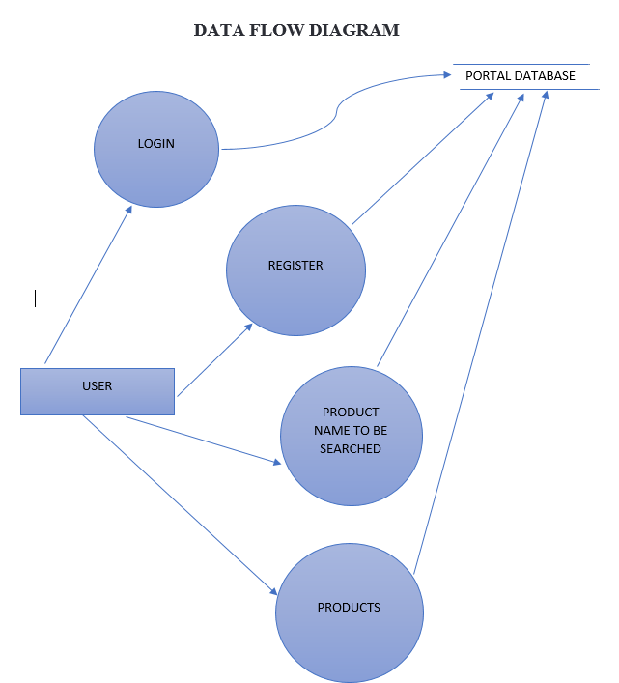
DATA FLOW DIAGRAM

Slide 5
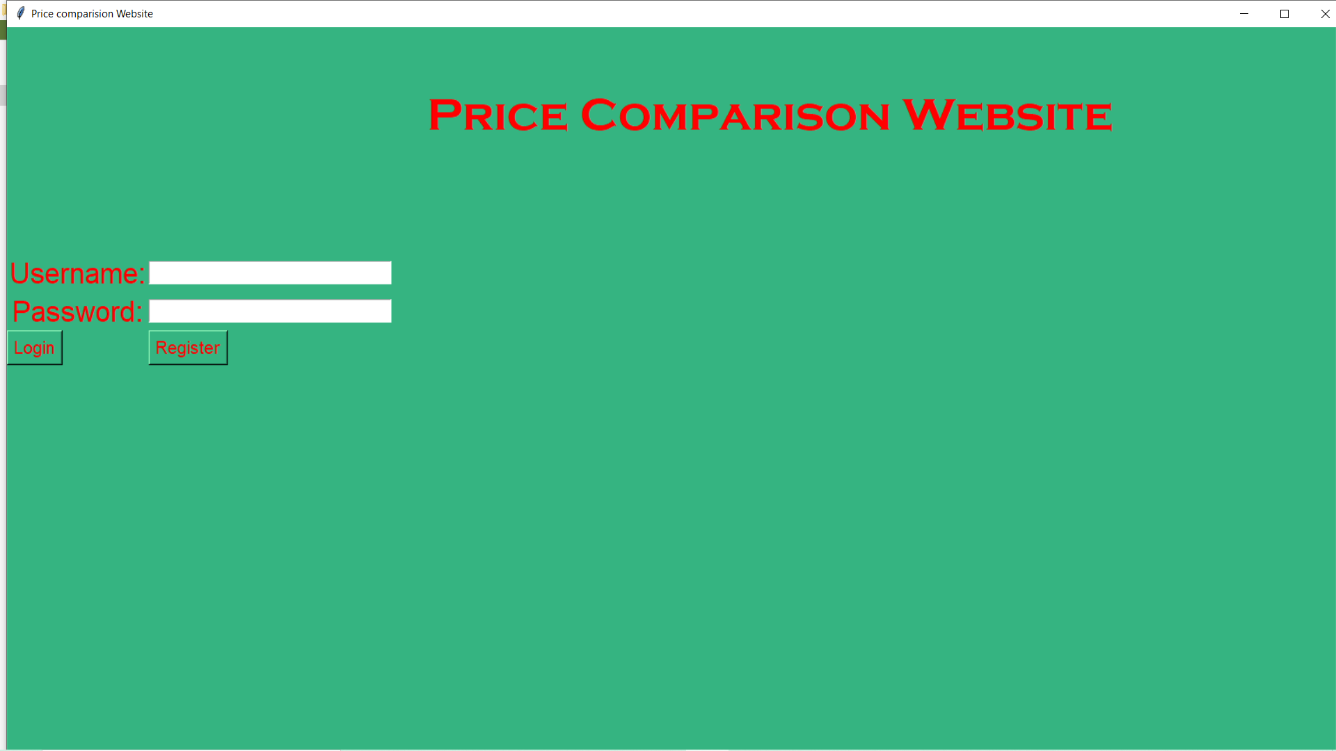
SCREEN SHOTS

Slide 6
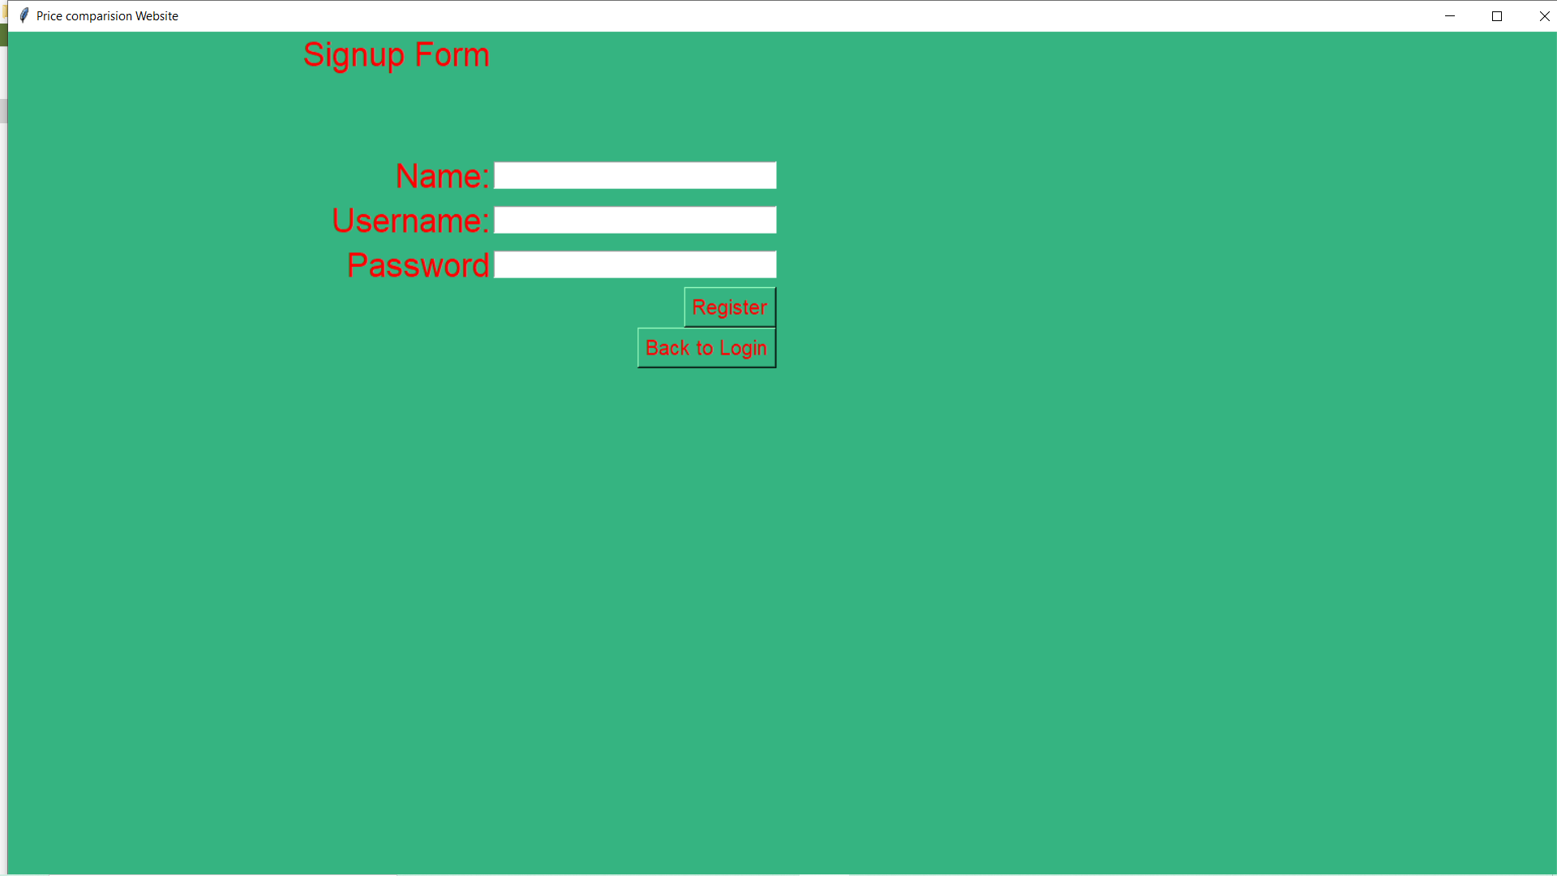

Slide 7
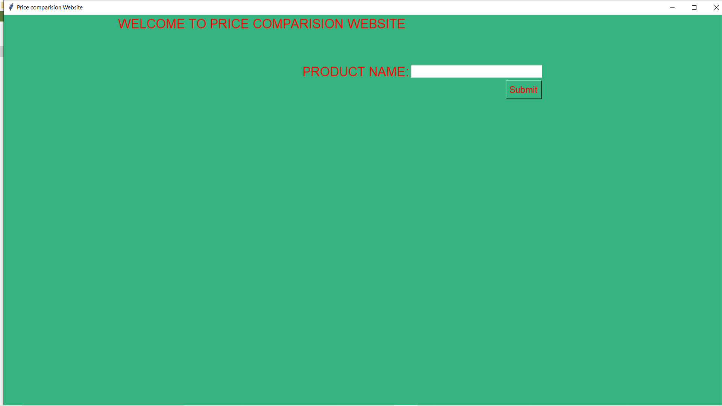

Slide 8
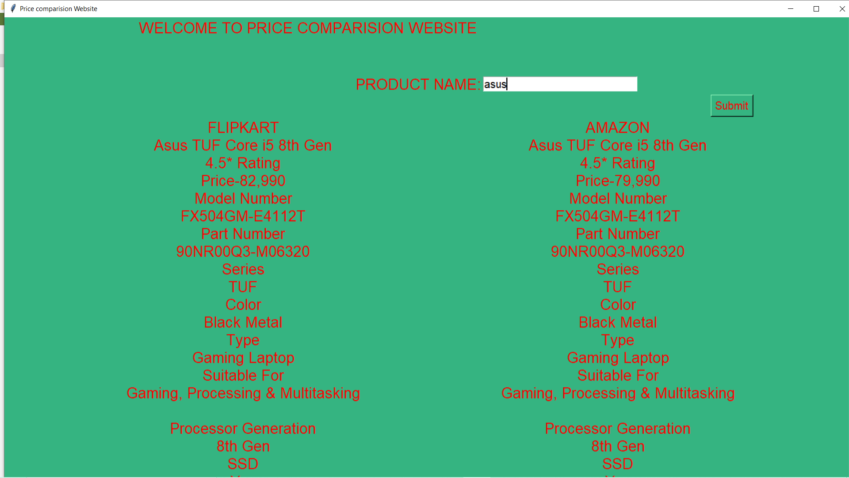

Slide 9

FUTURE SCOPE
Consumers use cost-comparison sites for two reasons: either to locate the lowest possible price on a specific item from a merchant with a good reputation, or to access information and reviews about a range of products in order to make a selection.
Pricing is the focus of most current shopping engines, although some small start-up companies are specializing in presenting product information to help buyers choose the right product, according to the SmartMoney website.
Even if the item is not purchased online, the consumer gains some perspective on whether the prices displayed in stores are good ones, factoring in what shipping costs might have been.

